Slide 1
CSE 185 Introduction to Computer Vision
Feature Matching

Slide 2
Feature matching
Keypoint matching
Hough transform
Reading: Chapter 4

Slide 3
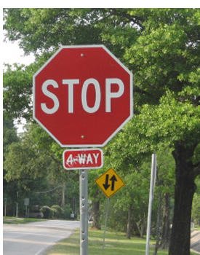
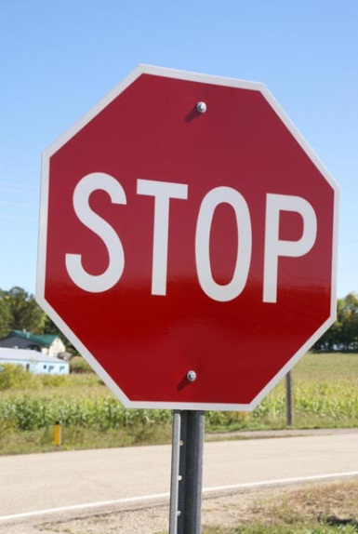
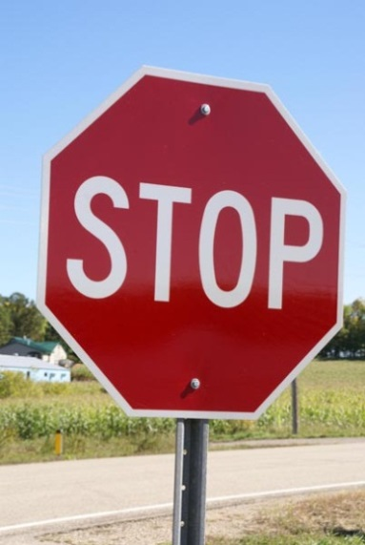
Feature matching
Correspondence: matching points, patches, edges, or regions across images
≈

Slide 4


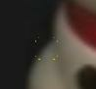
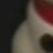
Keypoint matching
1. Find a set of distinctive key- points
A₁
B₃
2. Define a region around each keypoint
A₂
A₃
3. Extract and normalize the region content
B₁
B₂
4. Compute a local descriptor from the normalized region
5. Match local descriptors

Slide 5
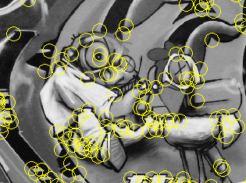
Review: Interest points
Keypoint detection: repeatable and distinctive
Corners, blobs, stable regions
Harris, DoG, MSER
SIFT

Slide 6
Which interest detector
What do you want it for?
Precise localization in x-y: Harris
Good localization in scale: Difference of Gaussian
Flexible region shape: MSER
Best choice often application dependent
Harris-/Hessian-Laplace/DoG work well for many natural categories
MSER works well for buildings and printed things
Why choose?
Get more points with more detectors
There have been extensive evaluations/comparisons
[Mikolajczyk et al., IJCV’05, PAMI’05]
All detectors/descriptors shown here work well

Slide 7
Local feature descriptors
Most features can be thought of as templates, histograms (counts), or combinations
The ideal descriptor should be
Robust and distinctive
Compact and efficient
Most available descriptors focus on edge/gradient information
Capture texture information
Color rarely used
Scale-invariant feature transform (SIFT) descriptor

Slide 8
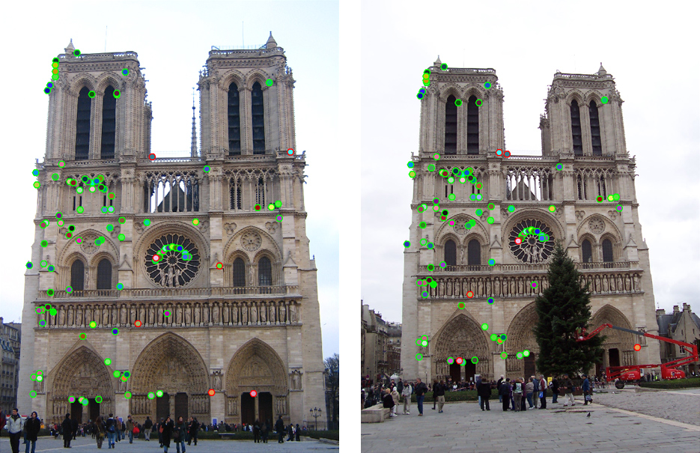
How to decide which features match?

Slide 9
Feature matching
Szeliski 4.1.3
Simple feature-space methods
Evaluation methods
Acceleration methods
Geometric verification (Chapter 6)

Slide 10
Feature matching
Simple criteria: One feature matches to another if those features are nearest neighbors and their distance is below some threshold.
Problems:
Threshold is difficult to set
Non-distinctive features could have lots of close matches, only one of which is correct

Slide 11
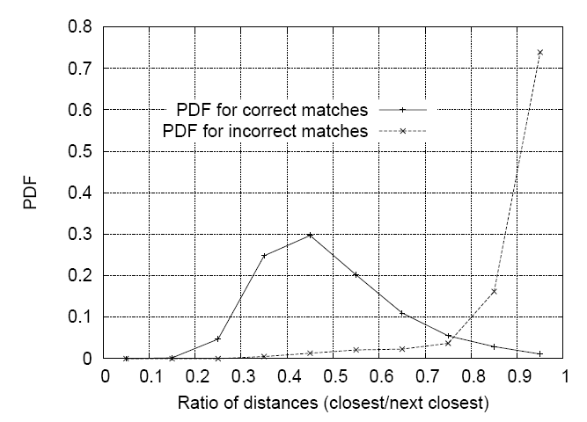
Matching local features
Threshold based on the ratio of 1st nearest neighbor to 2nd nearest neighbor distance
Reject all matches in which
the distance ration > 0.8, which
eliminates 90% of false matches
while discarding less than 5%
correct matches

Slide 12
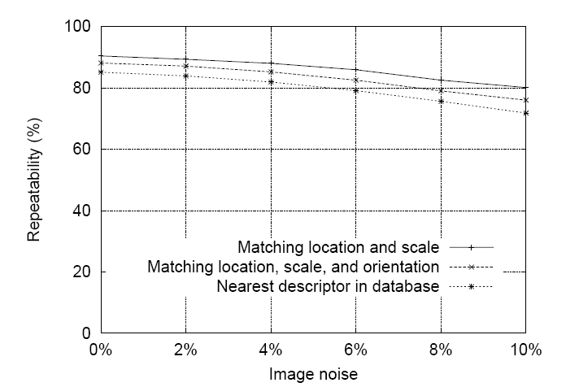
SIFT repeatability
It shows the stability of detection for keypoint location, orientation, and ﬁnal matching to a database as a function of afﬁne distortion. The degree of afﬁne distortion is expressed
in terms of the equivalent viewpoint rotation in depth for a planar surface.

Slide 13
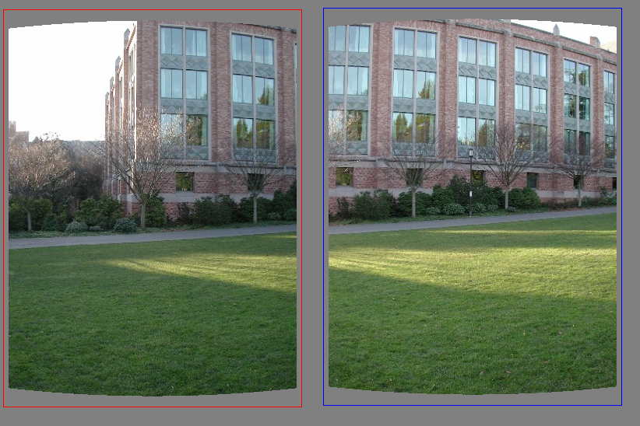
Matching features
What do we do about the “bad” matches?
Blue line: randomly selected line
Red line: outlier

Slide 14
RAndom SAmple Consensus
Select one match, count inliers
Blue line: randomly selected line
Red line: outlier

Slide 15
RAndom SAmple Consensus
Select one match, count inliers
Blue line: randomly selected line
Red line: outlier

Slide 16
Least squares fit
Find “average” translation vector
Blue line: randomly selected line
Red line: outlier

Slide 17
RANSAC
Random Sample Consensus
Choose a small subset uniformly at random
Fit to that
Anything that is close to result is signal; all others are noise
Refit
Do this many times and choose the best
Issues
How many times?
Often enough that we are likely to have a good line
How big a subset?
Smallest possible
What does close mean?
Depends on the problem
What is a good line?
One where the number of nearby points is so big it is unlikely to be all outliers
Notes:
This algorithm contains concepts that are hugely useful; in my experience, everyone with some
experience of applied problems who doesn’t yet know RANSAC is almost immediately able to use it to simplify some problem they’ve seen.

Slide 18
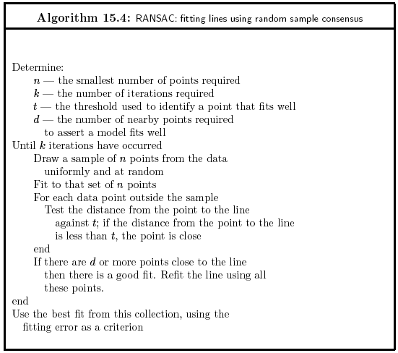

Slide 19
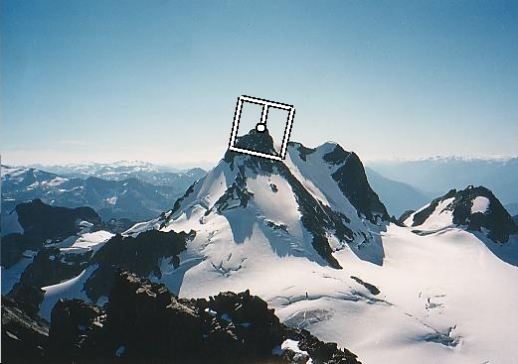
Descriptor Vector
Orientation = blurred gradient
Similarity Invariant Frame
Scale-space position (x, y, s) + orientation (θ)

Slide 20




RANSAC for Homography
SIFT features of two similar images

Slide 21
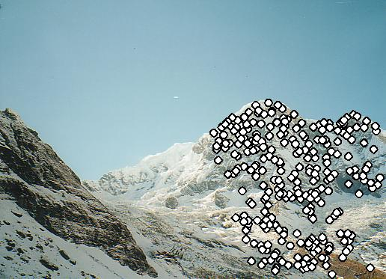
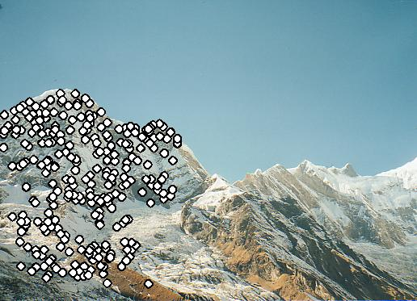
RANSAC for Homography
SIFT features common to both images

Slide 22
RANSAC for Homography
Select random subset of features (e.g. 6)
Compute motion estimate
Apply motion estimate to all SIFT features
Compute error: feature pairs not described by motion estimate
Repeat many times (e.g. 500)
Keep estimate with best error

Slide 23

RANSAC for Homography

Slide 24
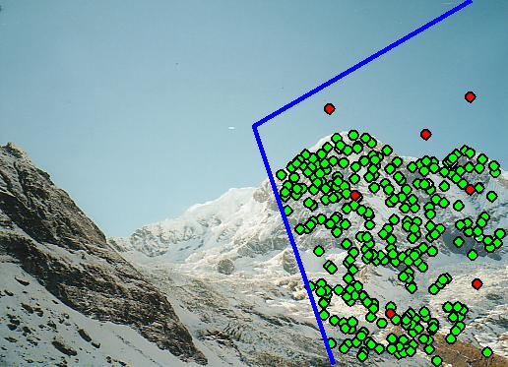
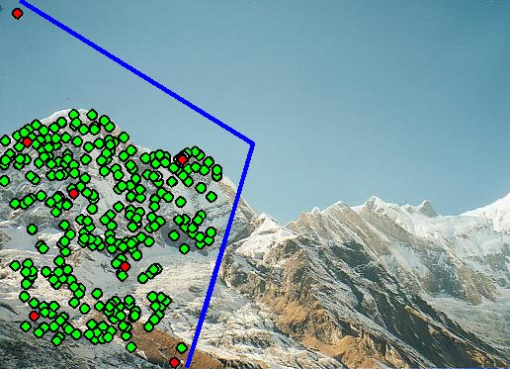
Probabilistic model for verification
Potential problem:
Two images don’t match…
… but RANSAC found a motion estimate
Do a quick check to make sure the images do match
MAP for inliers vs. outliers

Slide 25
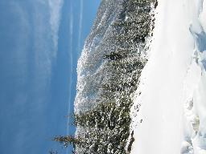
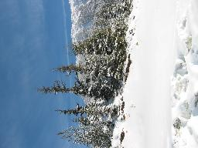
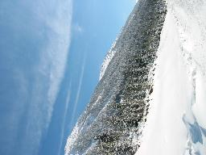
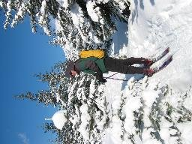
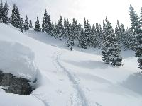
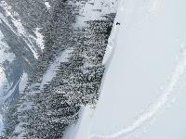
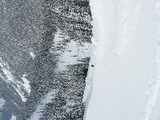
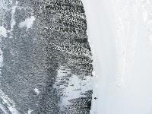
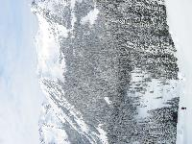
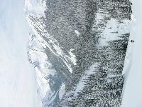
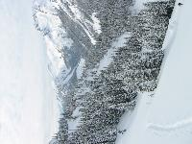
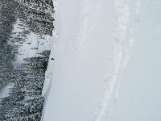
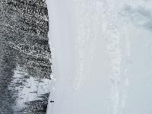
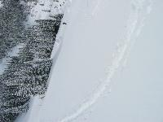
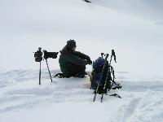
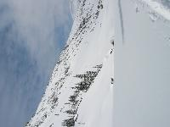
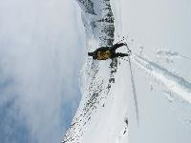
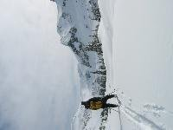
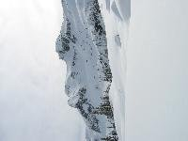
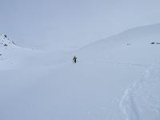
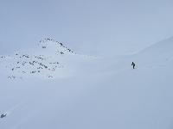
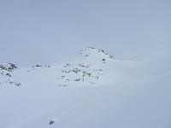
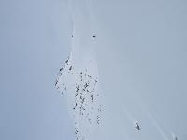
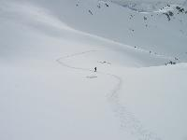
Finding the panoramas

Slide 26
Finding the panoramas
Finding connected
components

Slide 27
Finding the panoramas

Slide 28
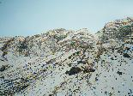

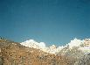
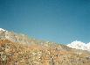
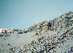
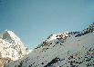
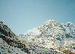
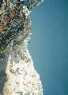

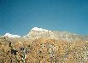
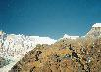
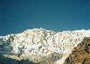














Results

Slide 29

Fitting and alignment
Fitting: find the parameters of a model that best fit the data
Alignment: find the parameters of the transformation that best align matched points

Slide 30

Checkerboard
Often used in camera calibration
See https://docs.opencv.org/master/d9/dab/tutorial_homography.html https://www.mathworks.com/help/vision/ref/estimatecameraparameters.html

Slide 31
Fitting and alignment
Design challenges
Design a suitable goodness of fit measure
Similarity should reflect application goals
Encode robustness to outliers and noise
Design an optimization method
Avoid local optima
Find best parameters quickly

Slide 32
Fitting and alignment: Methods
Global optimization / Search for parameters
Least squares fit
Robust least squares
Iterative closest point (ICP)
Hypothesize and test
Generalized Hough transform
RANSAC

Slide 33

Least squares line fitting
Data: (x₁, y₁), …, (x_{n}, y_{n})
Line equation: y_{i} = m x_{i} + b
Find (m, b) to minimize
y=mx+b
(x_{i}, y_{i})
Matlab: p = A \ y;

Slide 34
Least squares (global) optimization
Good
Clearly specified objective
Optimization is easy
Bad
May not be what you want to optimize
Sensitive to outliers
Bad matches, extra points
Doesn’t allow you to get multiple good fits
Detecting multiple objects, lines, etc.

Slide 35
Hypothesize and test
Propose parameters
Try all possible
Each point votes for all consistent parameters
Repeatedly sample enough points to solve for parameters
Score the given parameters
Number of consistent points, possibly weighted by distance
Choose from among the set of parameters
Global or local maximum of scores
Possibly refine parameters using inliers

Slide 36
Hough transform: Outline
Create a grid of parameter values
Each point votes for a set of parameters, incrementing those values in grid
Find maximum or local maxima in grid

Slide 37
Hough transform
Given a set of points, find the curve or line that explains the data points best
Duality: Each point has a dual line in the parameter space
y
m
x
b
Hough space
y = m x + b
m = -(1/x)b + y/x
m and b are known variables
y and x are unknown variables
x and y are known variables
m and b are unknown variables
Notes:
􀁑 Basic ideas
• A line is represented as . Every line in the image corresponds
to a point in the parameter space
• Every point in the image domain corresponds to a line in the parameter
space (why ? Fix (x,y), (m,n) can change on the line . In other
words, for all the lines passing through (x,y) in the image space, their
parameters form a line in the parameter space)
• Points along a line in the space correspond to lines passing through the
same point in the parameter space (why ?)

Slide 38
Hough transform
y
m
x
b
y
m
3
5
3
3
2
2
3
7
11
10
4
3
2
3
1
4
5
2
2
1
0
1
3
3
x
b
Notes:
􀁑 Basic ideas
• A line is represented as . Every line in the image corresponds
to a point in the parameter space
• Every point in the image domain corresponds to a line in the parameter
space (why ? Fix (x,y), (m,n) can change on the line . In other
words, for all the lines passing through (x,y) in the image space, their
parameters form a line in the parameter space)
• Points along a line in the space correspond to lines passing through the
same point in the parameter space (why ?)

Slide 39




Hough transform
Issue : parameter space [m,b] is unbounded…
Use a polar representation for the parameter space
y
Duality: Each point has a dual curve in the parameter space
x
Hough space
$$r=x\cos{θ}+y sin⁡θ$$
Notes:
􀁑 Basic ideas
• A line is represented as . Every line in the image corresponds
to a point in the parameter space
• Every point in the image domain corresponds to a line in the parameter
space (why ? Fix (x,y), (m,n) can change on the line . In other
words, for all the lines passing through (x,y) in the image space, their
parameters form a line in the parameter space)
• Points along a line in the space correspond to lines passing through the
same point in the parameter space (why ?)

Slide 40

Hough transform: Experiments
features
votes
Notes:
Figure 15.1, top half. Note that most points in the vote array are very dark, because they
get only one vote.

Slide 41

Hough transform

Slide 42

Hough transform: Experiments
Noisy data
features
votes
Need to adjust grid size or smooth
Notes:
This is 15.1 lower half

Slide 43

Hough transform: Experiments
features
votes
Issue: spurious peaks due to uniform noise
Notes:
15.2; main point is that lots of noise can lead to large peaks in the array

Slide 44


1. Image → Canny

Slide 45

2. Canny → Hough votes

Slide 46

3. Hough votes → Edges
Find peaks and post-process

Slide 47

Hough transform example

Slide 48
Hough transform: Finding lines
Using m,b parameterization
Using r, theta parameterization
Using oriented gradients
Practical considerations
Bin size
Smoothing
Finding multiple lines
Finding line segments

